Slide 1
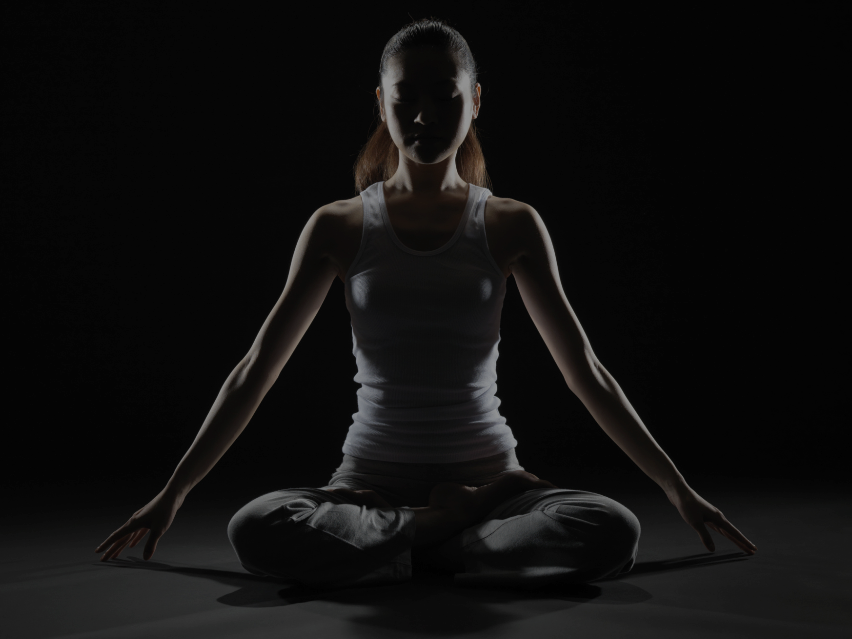


Slide 2
About Us
Our Program
Our Market
Pricings
Our Team
Our
Onboarding
Plan

Slide 3
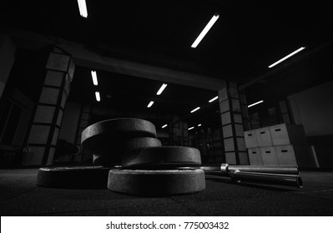
WHAT IS FITNESS BAR ?
“Our goal is to make health and fitness attainable, affordable and approachable.”

Slide 4
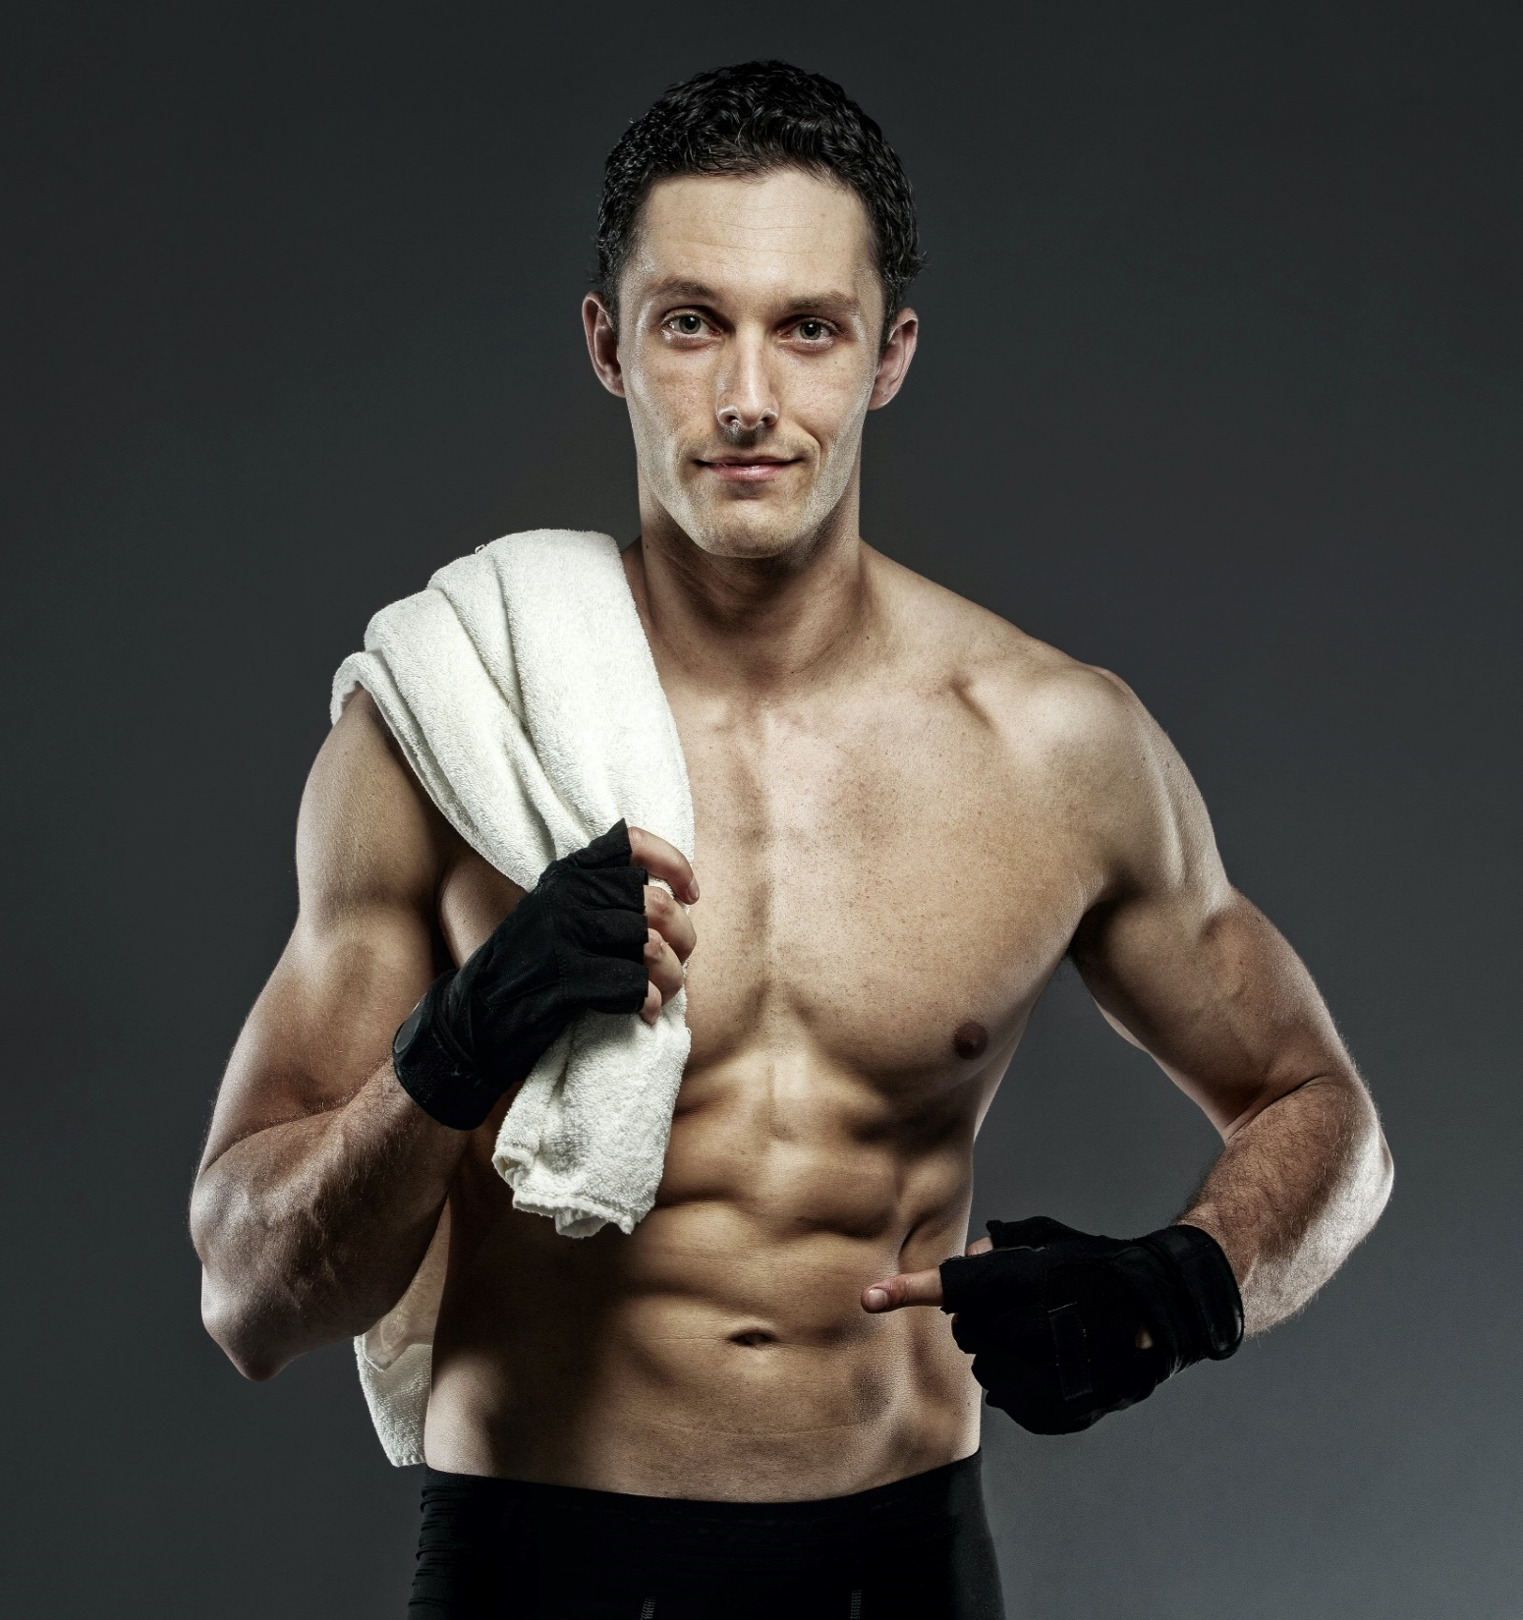
ABOUT US
“Created to help you live a
better, happier, healthier life.”
We believe fitness should be accessible to everyone, everywhere, regardless of income level or access to a gym. That's why we offer hundreds of free, full-length workout videos, the most affordable and effective workout programs on the web, meal plans, and helpful health, nutrition and fitness information.

Slide 5
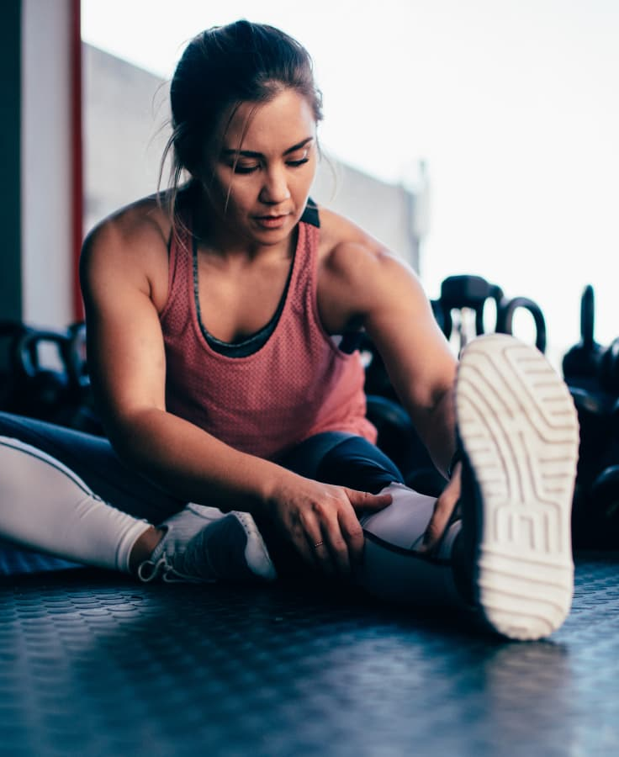





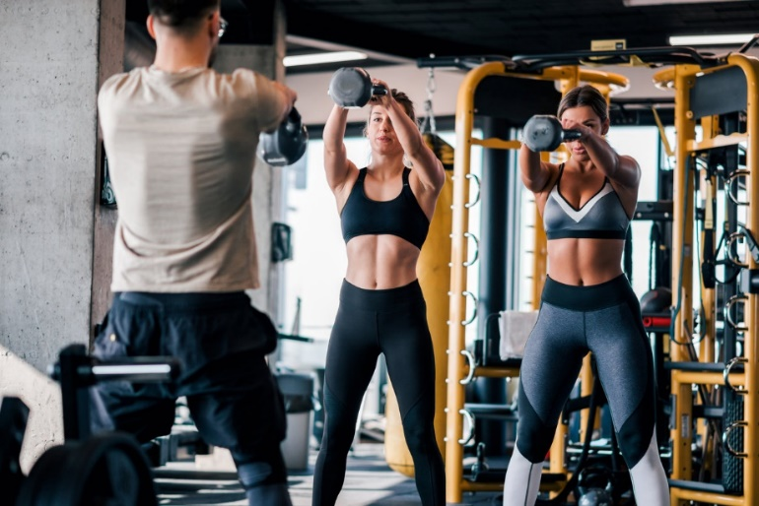

OUR PROGRAM
We provide free and premium services to all. So that everyone can join and we can make world a better place.
Workout Videos
Custom Workouts
Meal Plans
Workout Programs

Slide 6
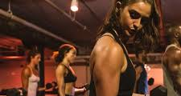
Target Audience
Our Market

Slide 7
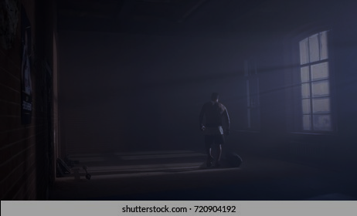
Our Packages
Pricing Tables
Silver Plan
Gold Plan
YOGA VIDEOS
LIVE SESSIONS
FITNESS PLANS
DIET PLANS
EXTENDED DIET PLANS
1 Month Plan
YOGA VIDEOS
LIVE SESSIONS
FITNESS PLANS
DIET PLANS
EXTENDED DIET PLANS
1 Year Plan

Slide 8
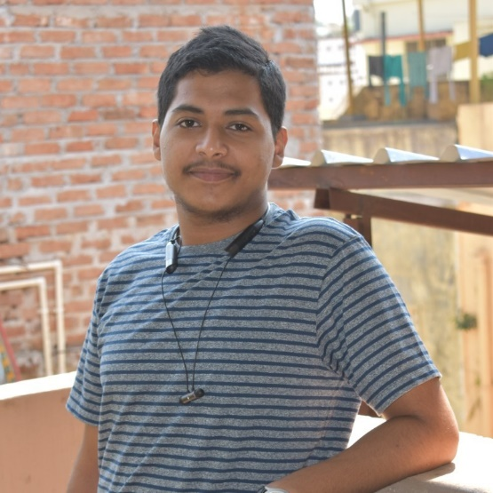
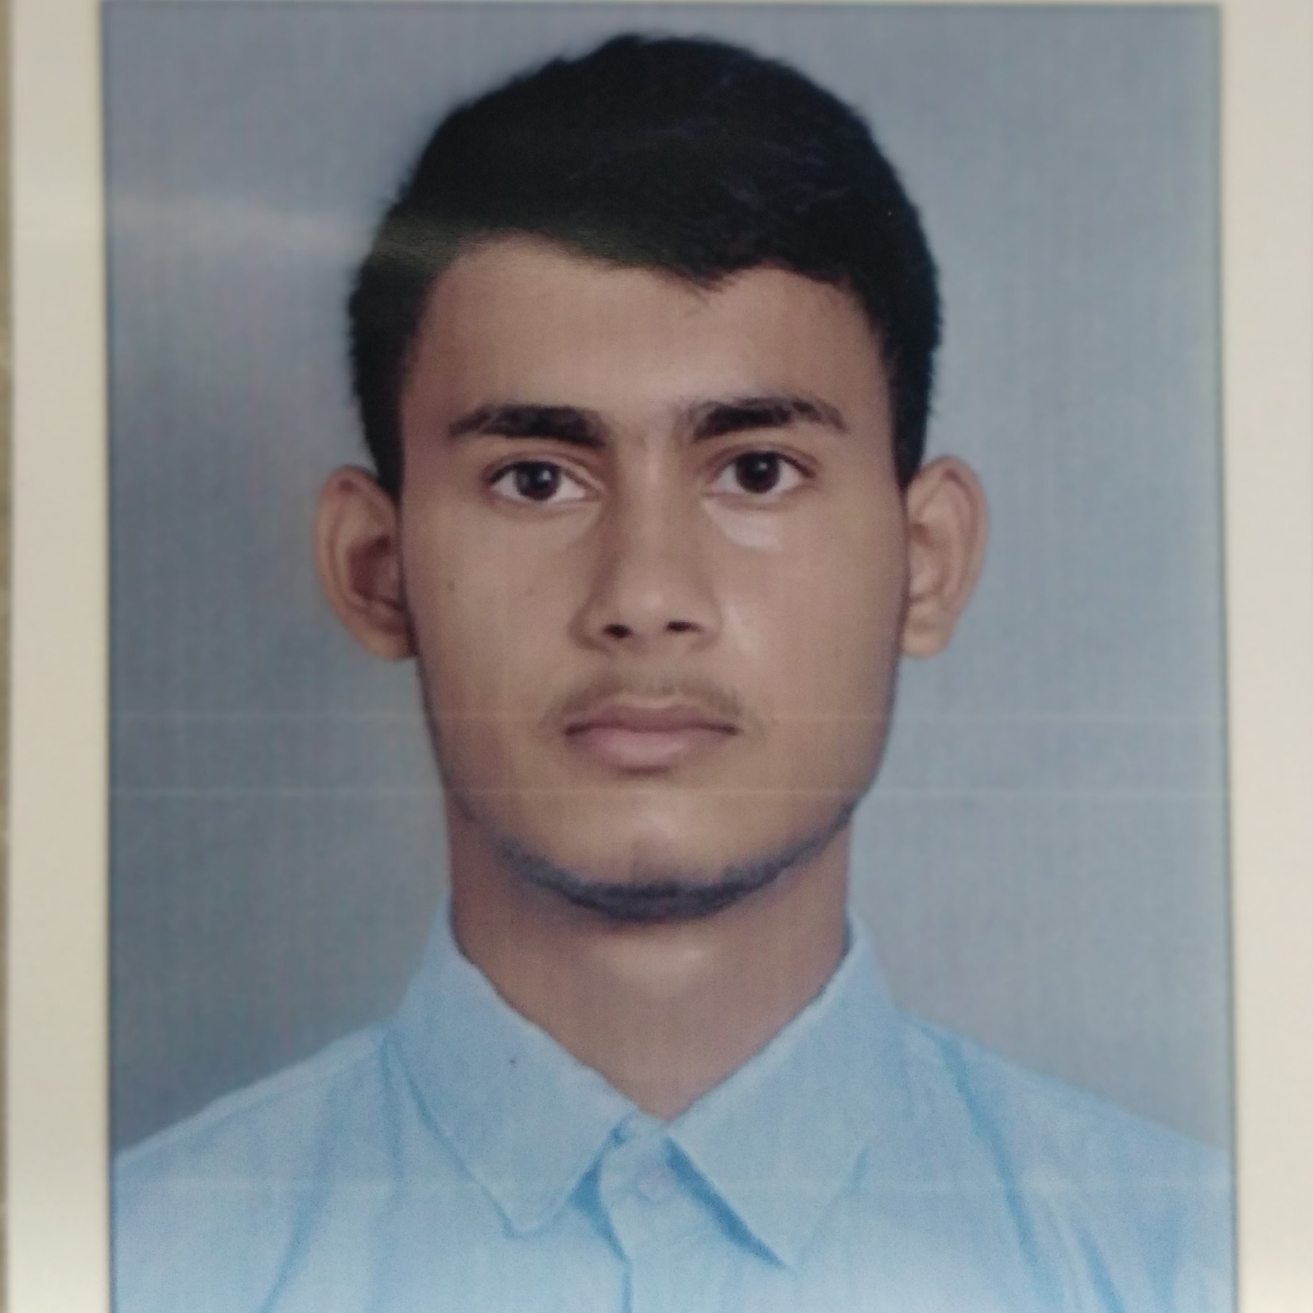
Our Team
Lingaraj Sahu
B.tech
Vijay Pratap Singh
M.tech
Shivam Kumar
B.tech
Sajan Sanouria
B.tech
lingarajs2002@gmail.com
lingarajs2002@gmail.com
lingarajs2002@gmail.com
lingarajs2002@gmail.com

Slide 9
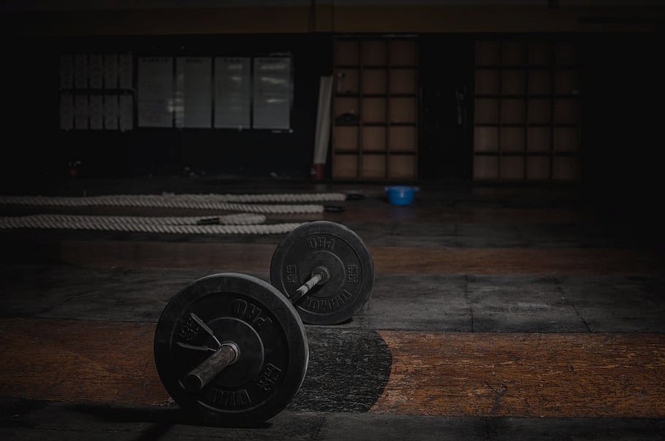
We are Here
Our Location
Balay Gumamela
Gym Hall
UP Visayas
Miago 5023 Iloilo
Miagao 5023
www.fitnessbar.glitch.me

